Slide 1
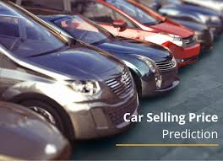
CAR PRICE PREDICTION
Prepared by- Umesh Mahajan

Slide 2
AGENDA
Introduction​
Problem Statement
Business Goal
Technical Requirement
Exploratory Data Analysis (EDA)
Data Pre-Processing
Visualization
Built Model
Saved Best Model
Summary​

Slide 3
INTRODUCTION
With the covid 19 impact in the market, we have seen lot of changes in the car market. Now some cars are in demand hence making them costly and some are not in demand hence cheaper. One of our clients works with small traders, who sell used cars. With the change in market due to covid 19 impact, our client is facing problems with their previous car price valuation machine learning models. So, they are looking for new machine learning models from new data. We have to make car price valuation model. This project contains two phase:
Data Collection Phase : We have to scrape at least 5000 used cars data. We can scrape more data as well, it’s up to us. More the data better the model. In this section we need to scrape the data of used cars from websites (Olx, cardekho, Cars24 etc.) We need web scraping for this. We have to fetch data for different locations. The number of columns for data doesn’t have limit, it’s up to us and our creativity. Generally, these columns are Brand, model, variant, manufacturing year, driven kilometers, fuel, number of owners, location and at last target variable Price of the car. This data is to give us a hint about important variables in used car model. We can make changes to it, we can add or you can remove some columns, it completely depends on the website from which we are fetching the data. Try to include all types of cars in our data for example- SUV, Sedans, Coupe, minivan, Hatchback.
Model Building Phase : After collecting the data, you need to build a machine learning model. Before model building do all data pre-processing steps. Try different models with different hyper parameters and select the best model. Follow the complete life cycle of data science

Slide 4
Business Requirement
One of our clients works with small traders, who sell used cars. With the change in market due to covid 19 impact, our client is facing problems with their previous car price valuation machine learning models. So, they are looking for new machine learning models from new data. We have to make car price valuation model. This project contains two phases:
Data Collection Phase
Model Building Phase

Slide 5
Exploratory Data Analysis (EDA)
Checked Total Numbers of Rows and Column
Checked All Column Name
Checked Data Type of All Data
Checked for Null Values
Checked for special character present in dataset or not
Checked total number of unique value
Dropped irrelevant Features
Replaced duplicate values, special characters and irrelevant data
Checked Information about Data
Checked all features through visualization.

Slide 6


Dropping unnamed Index
Checking shape of data we can see that we have total 5373 rows and 8 columns

Slide 7
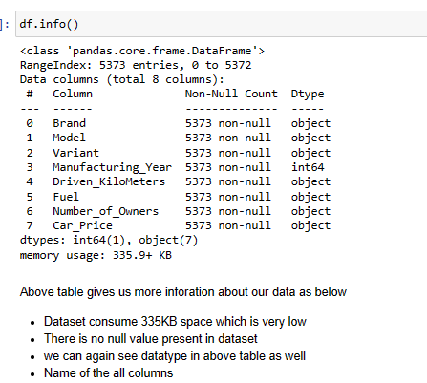
Getting Basic understanding of dataset

Slide 8
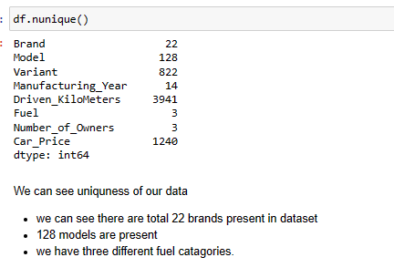
Looking for the uniqueness of Dataset
In Jupytor Note book I have seen and observed all Unique values present in dataset

Slide 9
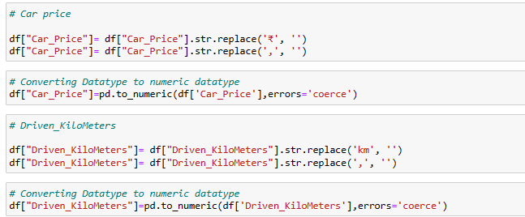
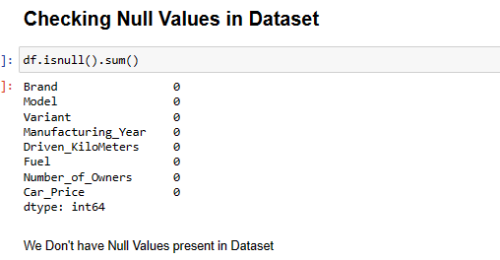
Data cleaning and removing unnecessary symbols and spaces

Slide 10
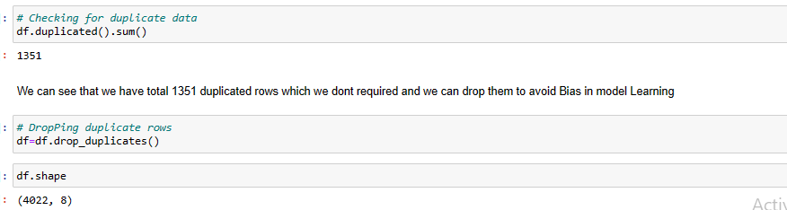
As I found some duplicate rows in dataset I removed those duplicate values

Slide 11
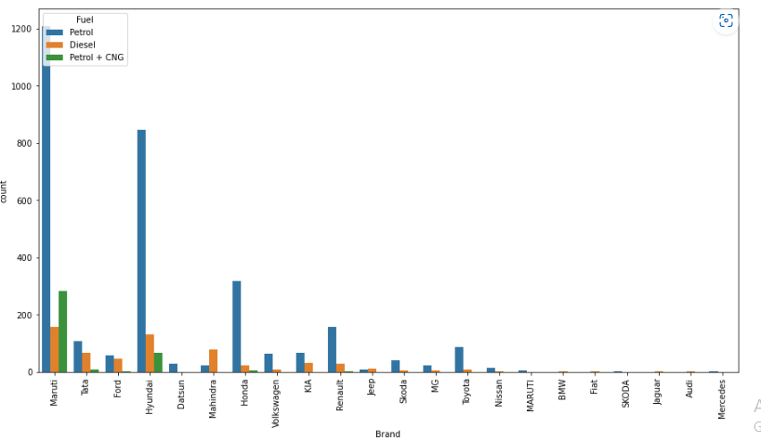
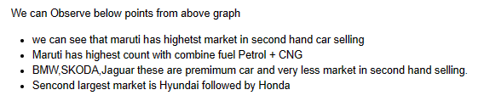
Visualization of Data

Slide 12
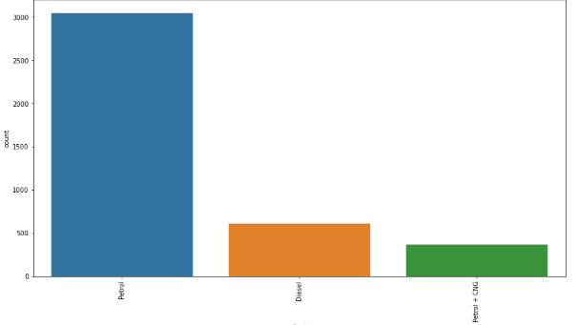
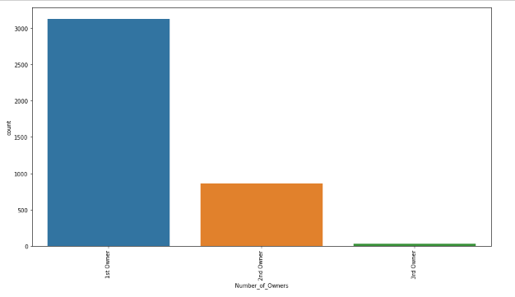
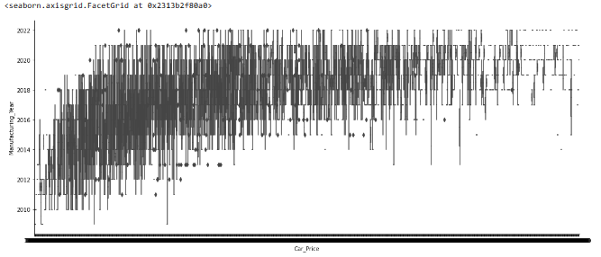

Slide 13
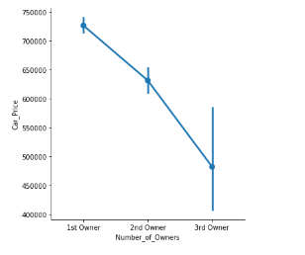
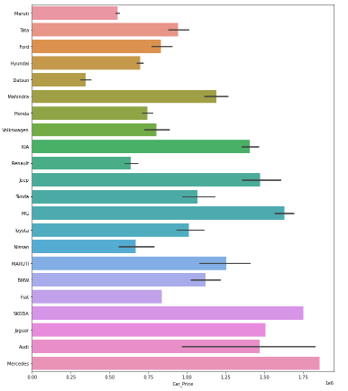
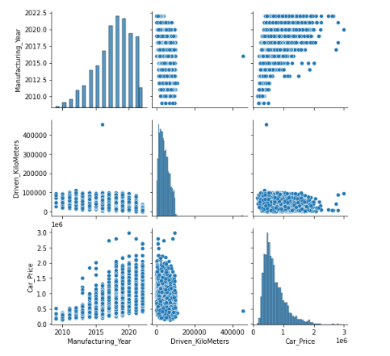

Slide 14
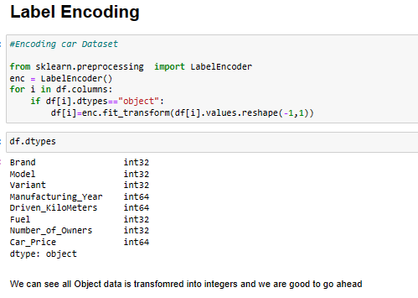
Converted categorical values in numeric using Label encoder

Slide 15
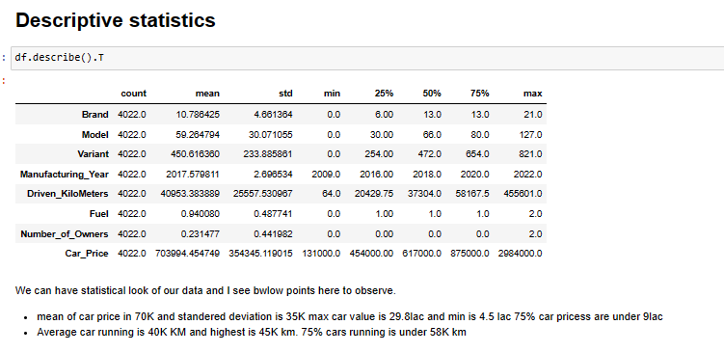
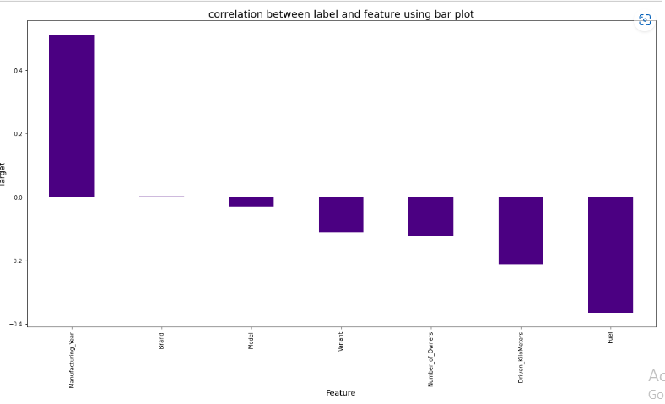
Correlations matrix

Slide 16
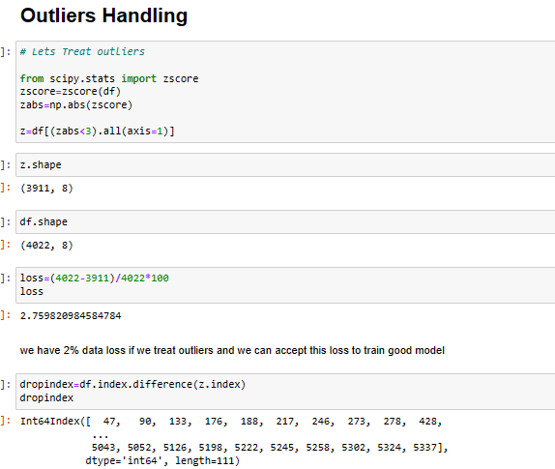
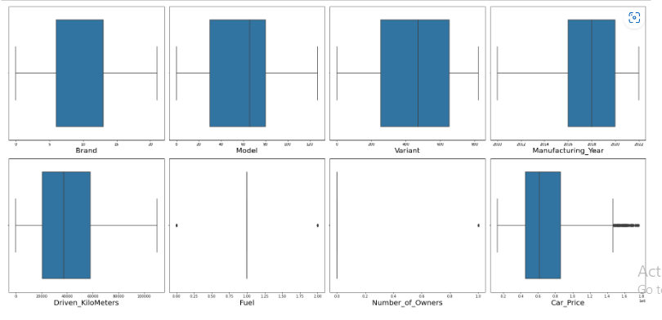
Removed Outliers present in dataset using Z-score

Slide 17
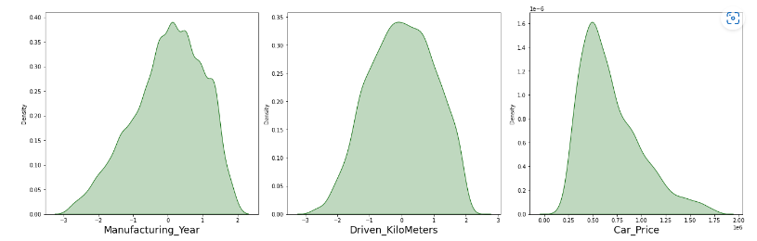
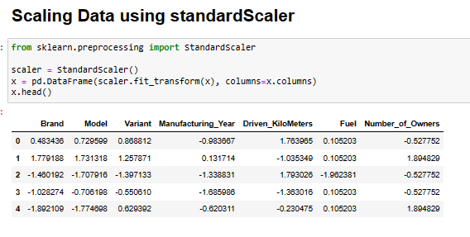
Removed Skewness

Slide 18
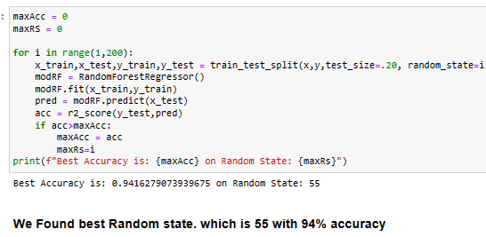

Found Best Random state

Slide 19
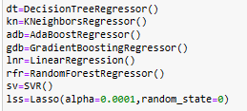
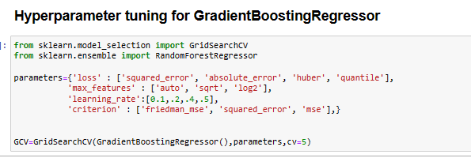
Trained below Models
Considering performance matrix of all models I found GradientBoostingRegressor
as best performing model

Slide 20
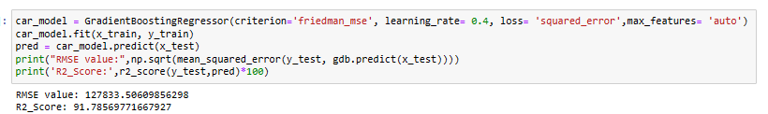
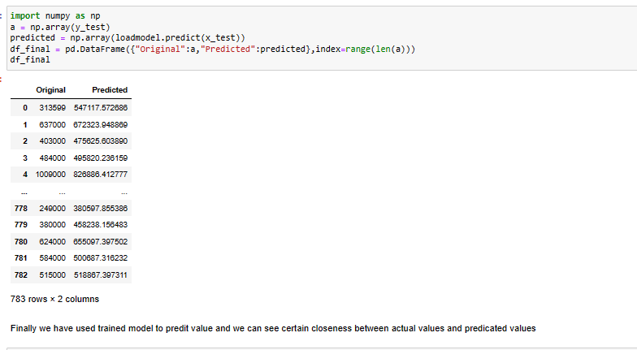
Saved Final model with 91 % R2_score

Slide 21
Conclusion:
As Per business requirement we collected live data from Cars24. com website using web scarpping.
We converted data in cvs and did EDA before using data
We cleaned our data
Removed duplicated rows from data
Visualized all variables using different charts and graphs and gain understanding trends.
Handled and converted categorical data in numeric format
Did descriptive analysis of dataset
Handled outliers and skewness of data
Finally trained best model which is GradientBoostingRegressor wit 91% R2 score

